Slide 2
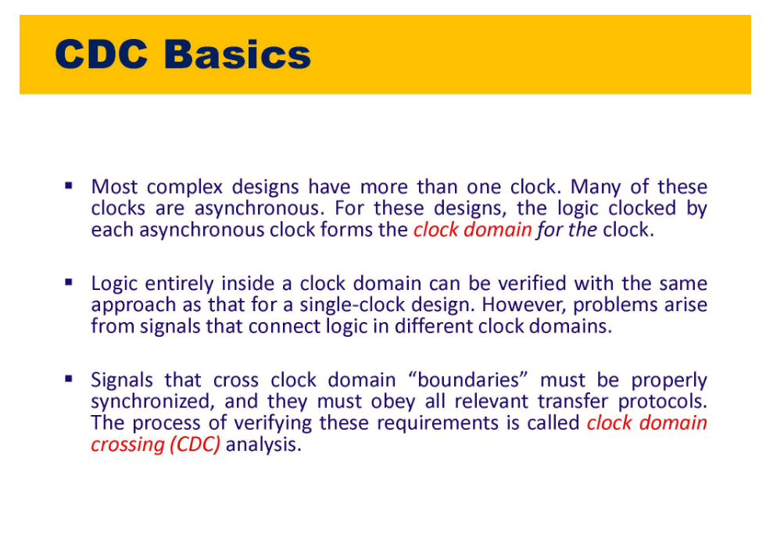

Slide 3
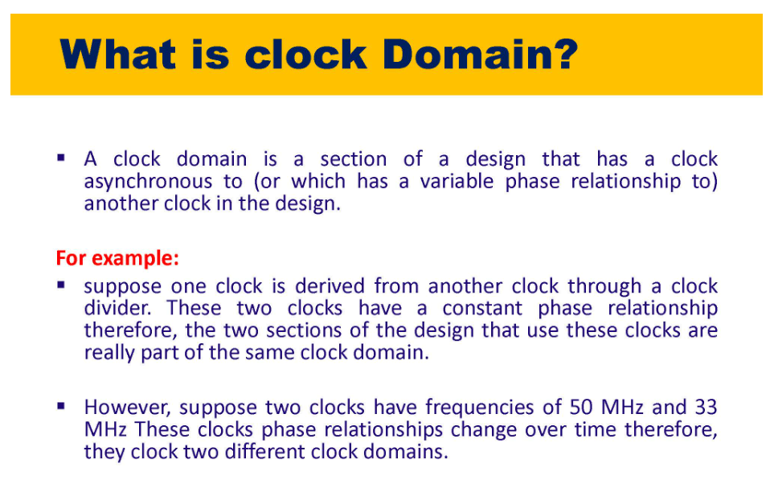

Slide 4
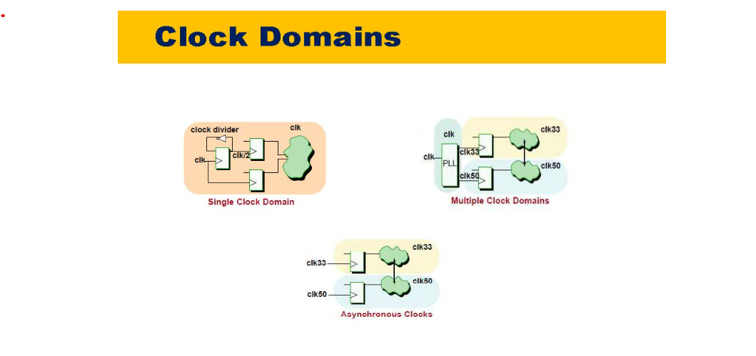
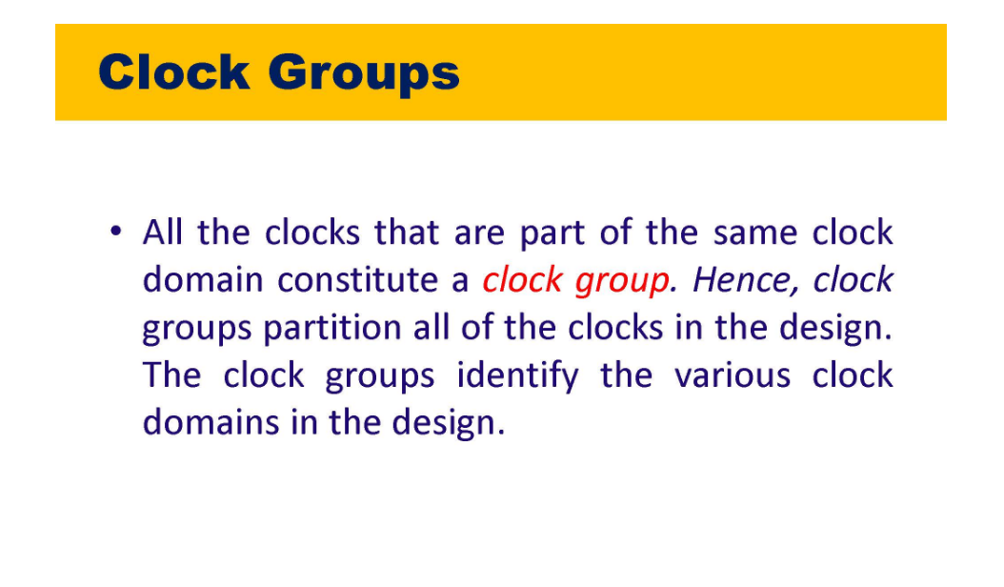

Slide 5
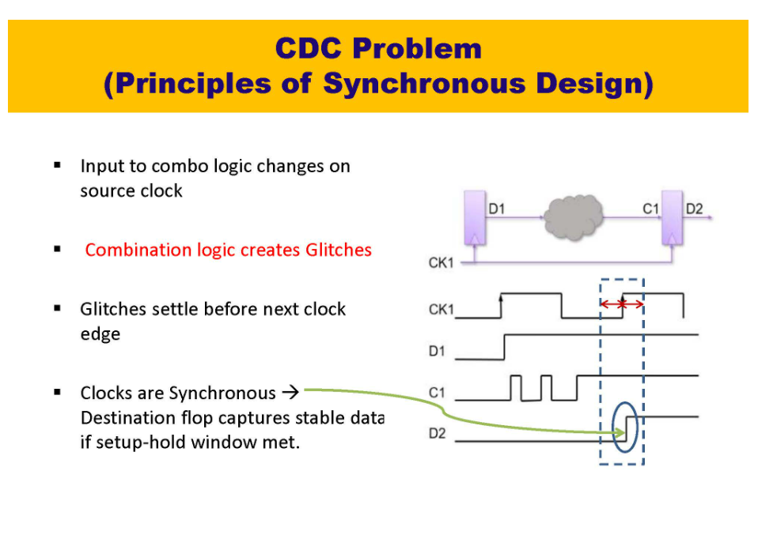

Slide 6
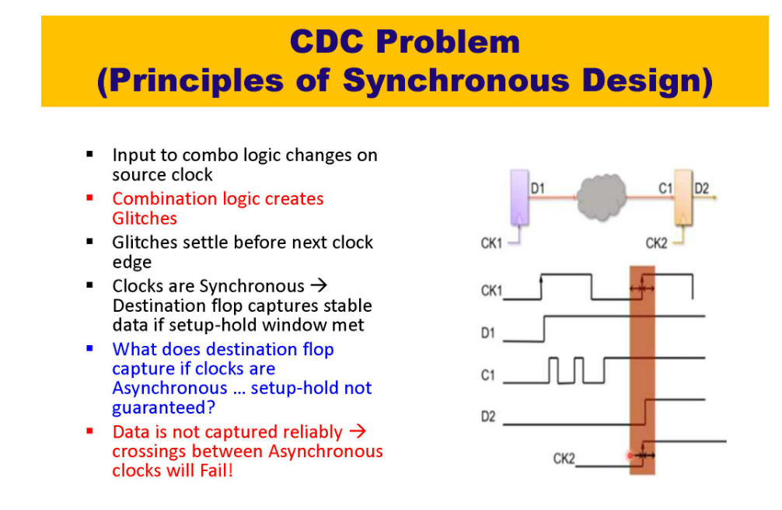

Slide 7
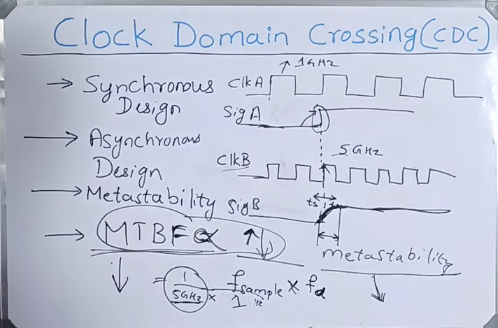
Metastability and MTBF
* MTBF is inversely proportional to frequency of data and frequency of sampling clock

Slide 8
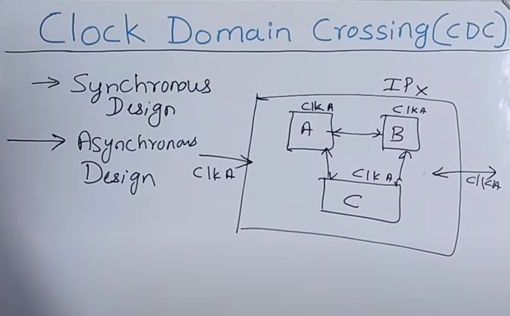
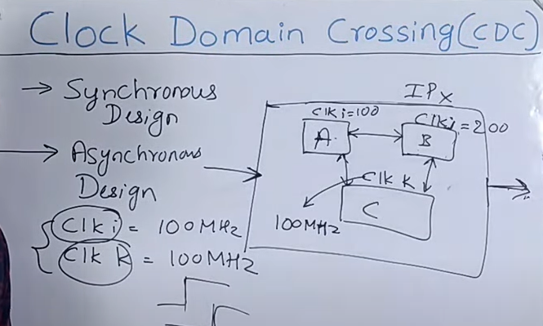
Notice that even if two clocks have same frequency say 100 MHz but if they’re derived from different PLL’s or crystals then they will have phase difference between them and hence they will be counted as Asynchronous Flops only

Slide 9
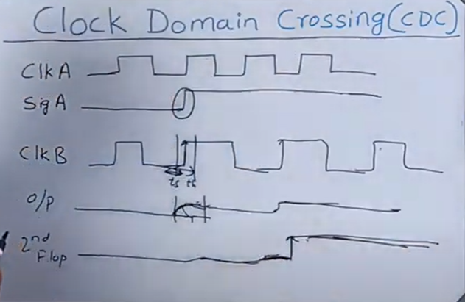
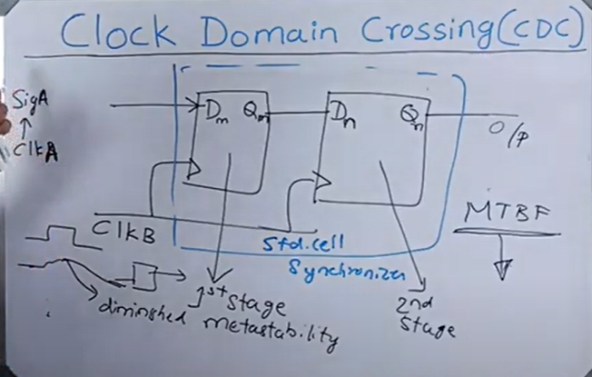
2 Flop Synchronizers
https://www.youtube.com/watch?v=fwh-KISWs7c&list=UULF3mTACG8vPWsHQFMfxzeDZg&index=24
Notice that second flop in the synchronizer is placed as close as possible to first one because we don’t want signal from metastable state to get diminished

Slide 10
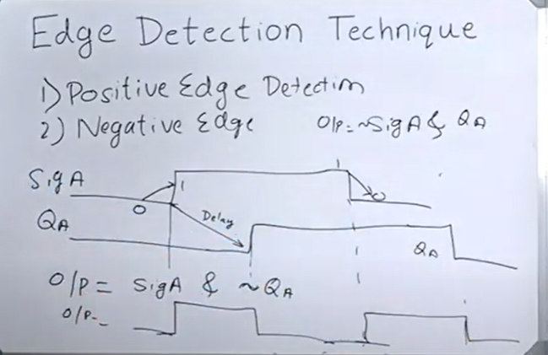
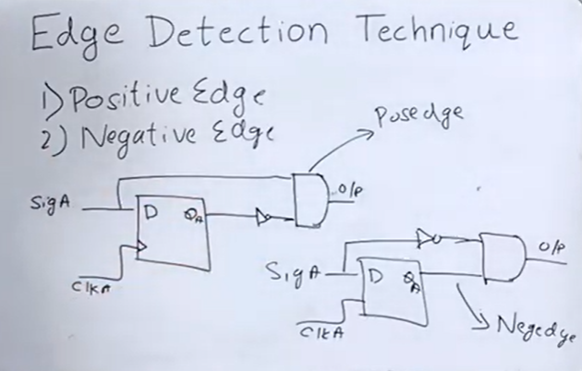
Edge Detection Techniques
https://www.youtube.com/watch?v=m2D4iYep_pQ&list=UULF3mTACG8vPWsHQFMfxzeDZg&index=24

Slide 11
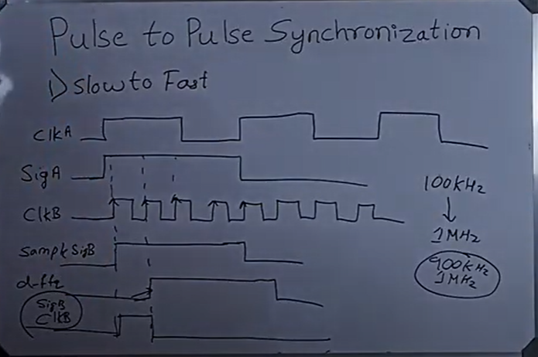
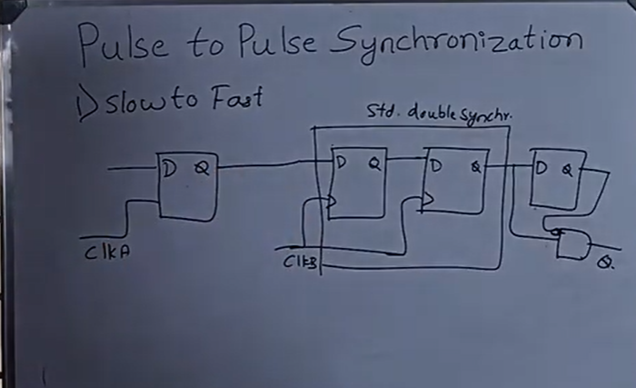
Pulse to Pulse Synchronization - Slow to Fast Clock Domain
Notice that pulse is a signal (SigA here) whose high is equal to period of the clockA.
Also notice that this is true only when clkA is very slow as compared to clkB, else say if clkA is 900kHz and clkB is 1MHz then the signal can go to metastable state.
Notice that SigA has to be wide enough for clkB to be captured.
We need edge detection at the end because now the pulse needs to be of the period of the CLK domain B
https://www.youtube.com/watch?v=ovQ5VYlEc8o

Slide 12
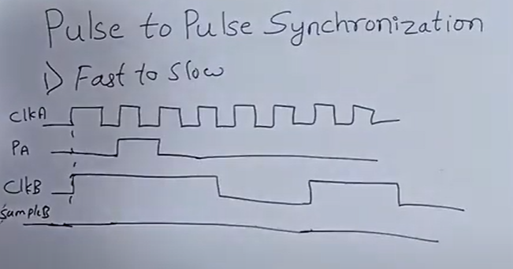
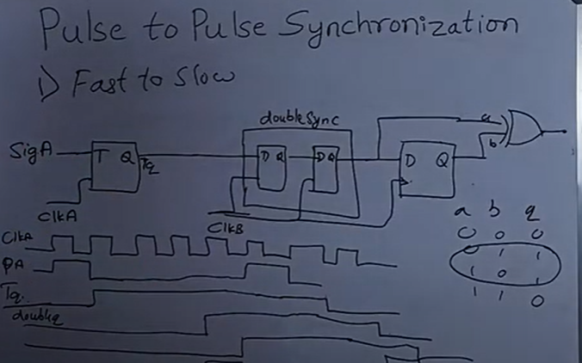
Pulse to Pulse Synchronization - Fast to Slow Clock Domain
For fast to slow there are two mechanisms. One is toggle based flop and other is handshake mechanism.
Handshake mechanism is employed when you don’t know the frequency of source and destination domain.
With the help of a T-Clock a pulse is converted to a level.
Notice however that this approach has some limitations. It is not used when input PA changes very frequently because then there is a possibility that before you sample this signal into domain B you might have entered the metastable state and by then the new input has come and so you’re likely to miss out that pulse
Input signal should not toggle so quickly before it gets captured in the destination domain.

Slide 13
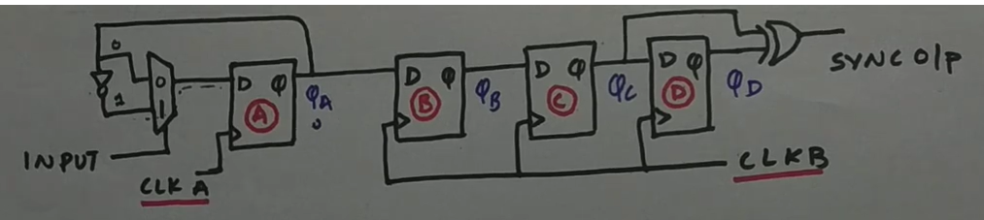
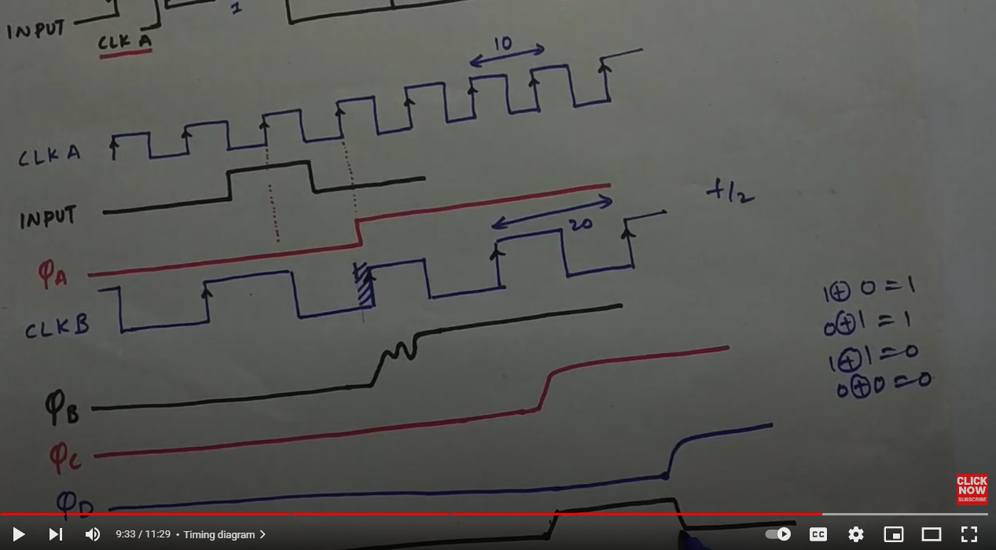
Pulse to Pulse Synchronization - Fast to Slow Clock Domain
https://www.youtube.com/watch?v=Fs0AJmESX3c
The main point is to convert a pulse to a level, so that we can get an input when the pulse has been triggered, this will be passed to a clock to synchronize it.

Slide 14
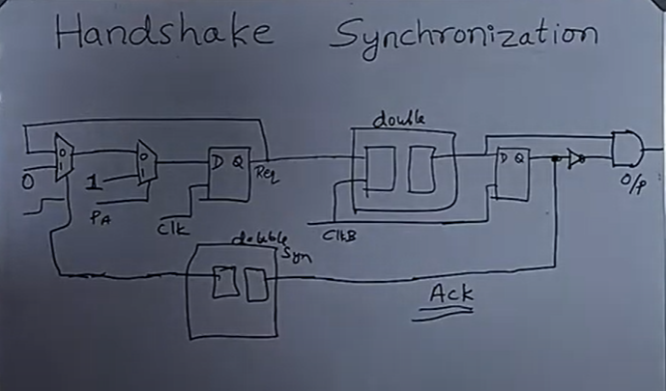
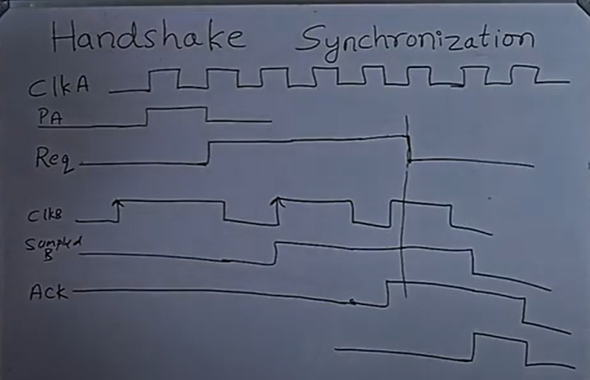
Handshake Synchronization
Acknowledgement from the destination domain brings down the pulse PA of the source clock domain
https://www.youtube.com/watch?v=qDnWYp1nG9I

Slide 15
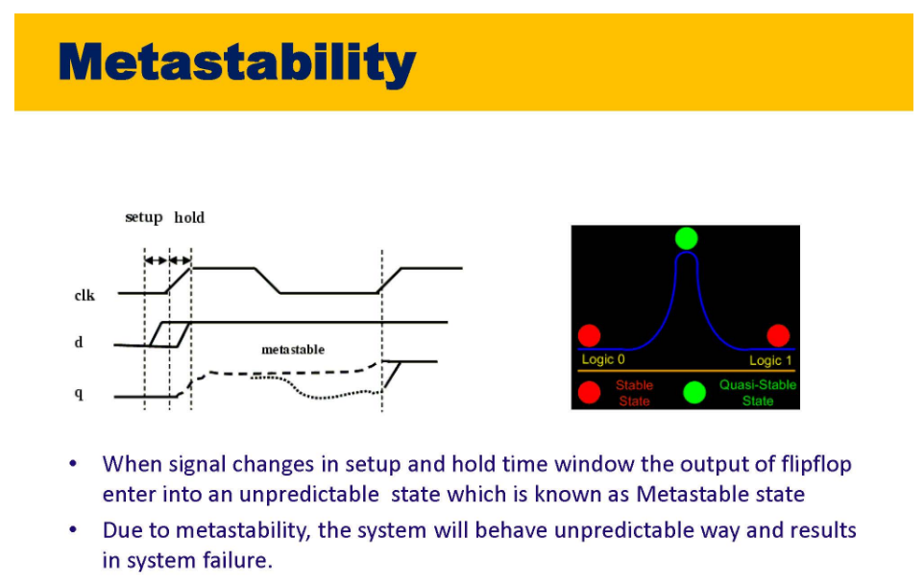

Slide 16
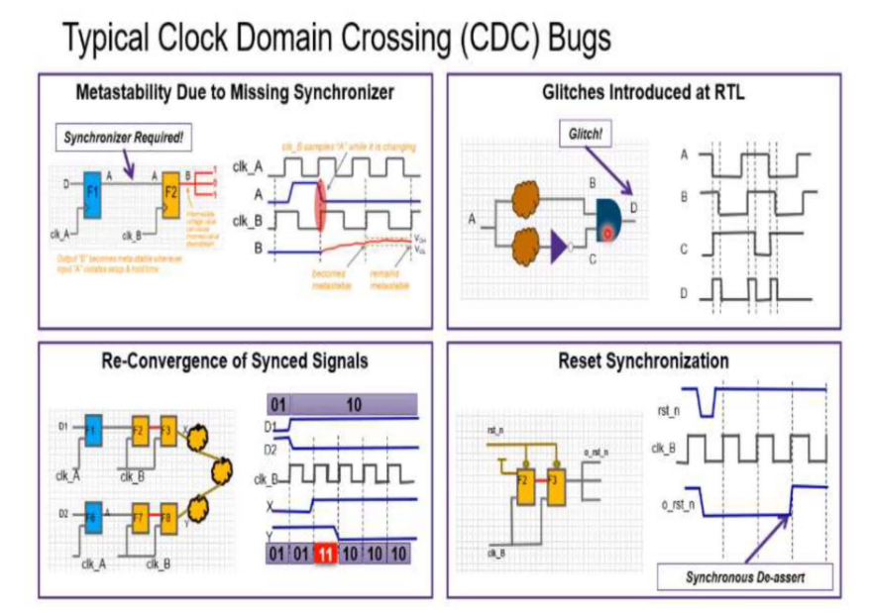
Typical CDC Bugs
Metastability due to missing synchronizer
Glitches Introduced at RTL
Convergence, Divergence and Re-Convergence of clock
Reset Synchronization

Slide 17
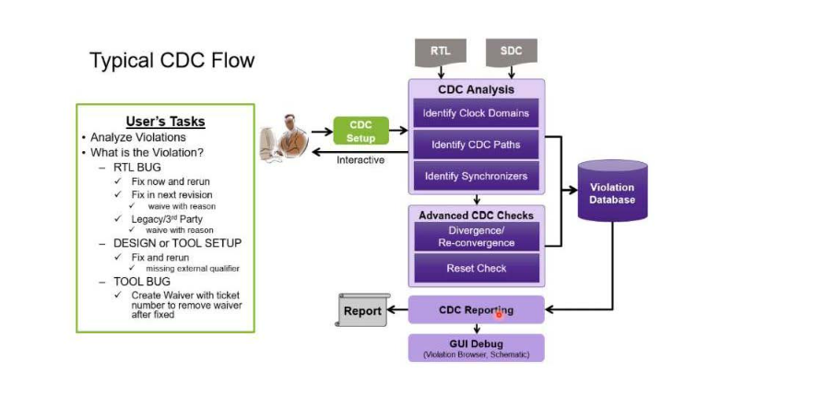

Slide 18
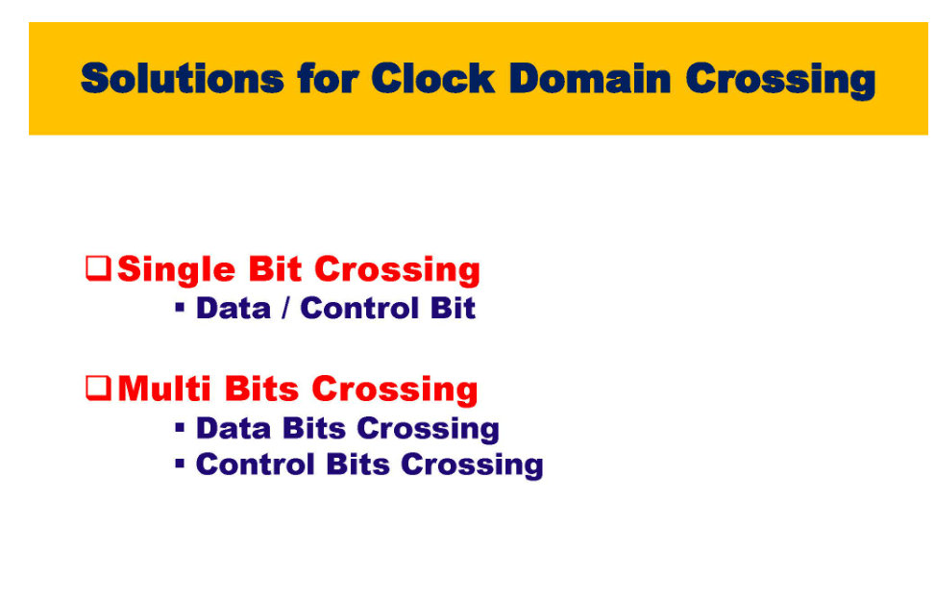

Slide 19
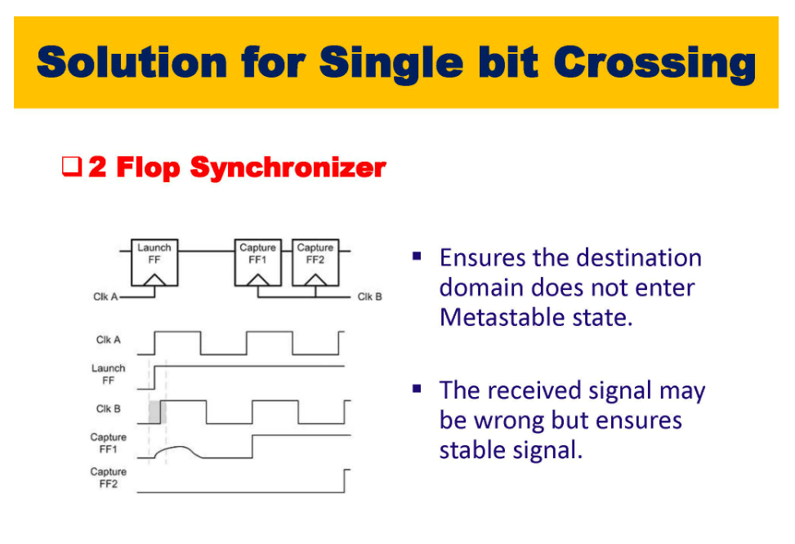

Slide 20
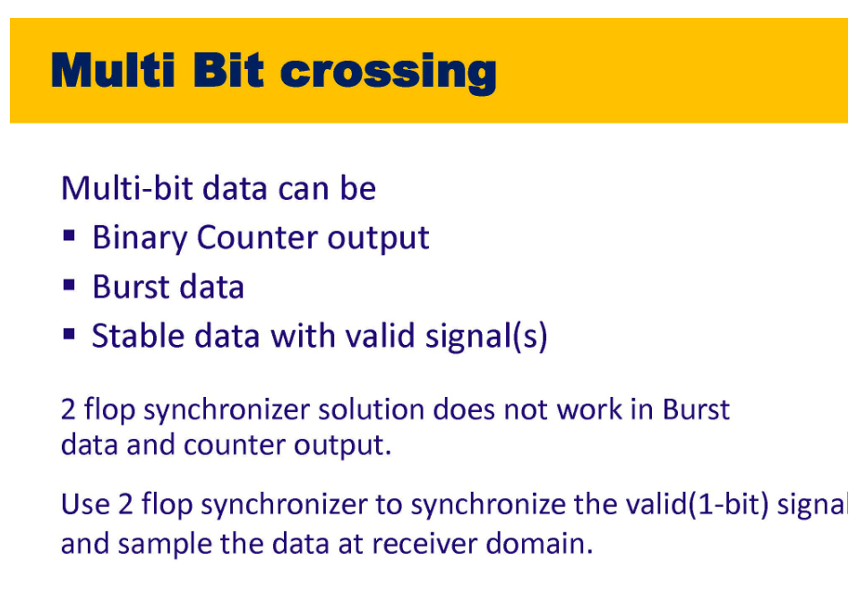

Slide 21
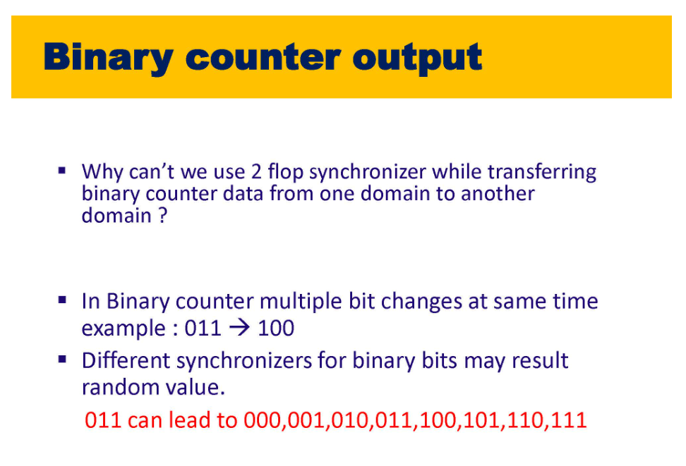

Slide 22
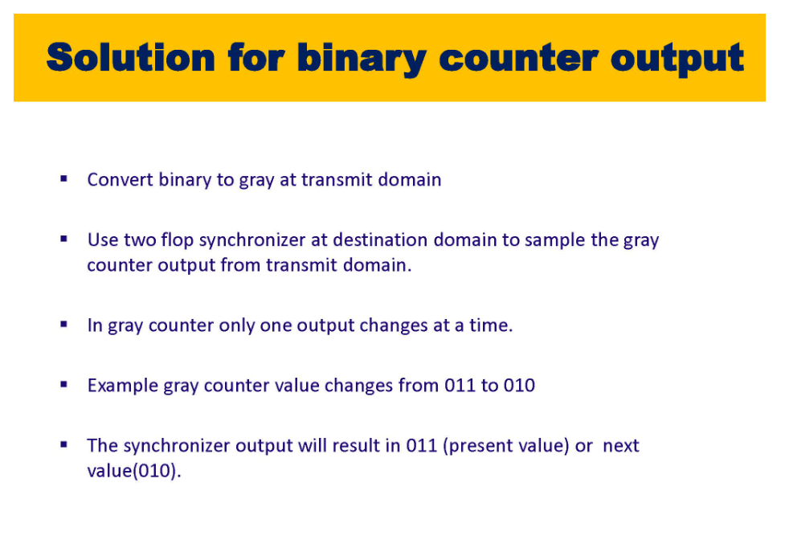

Slide 23
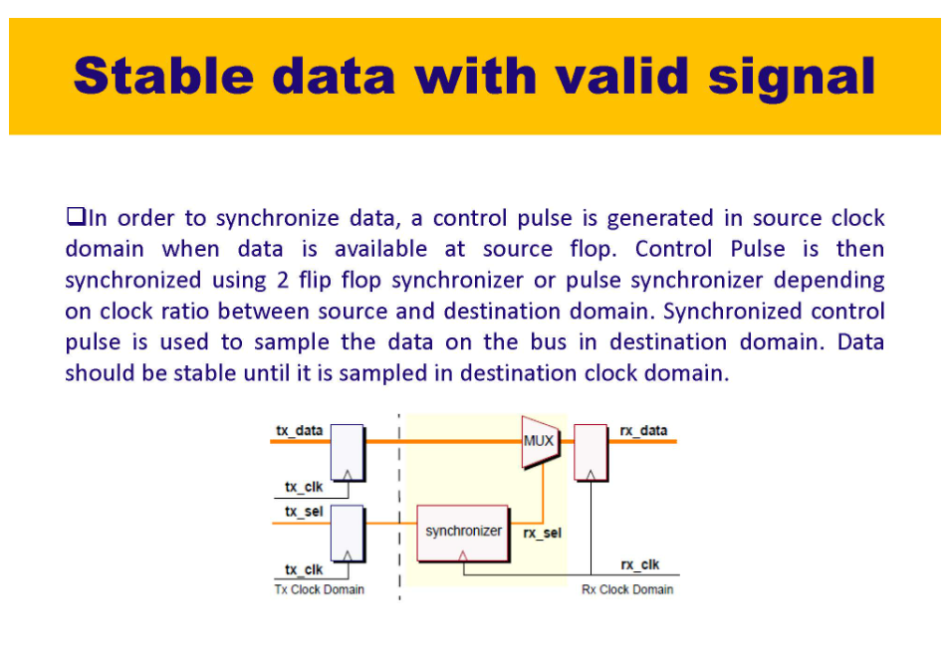

Slide 24
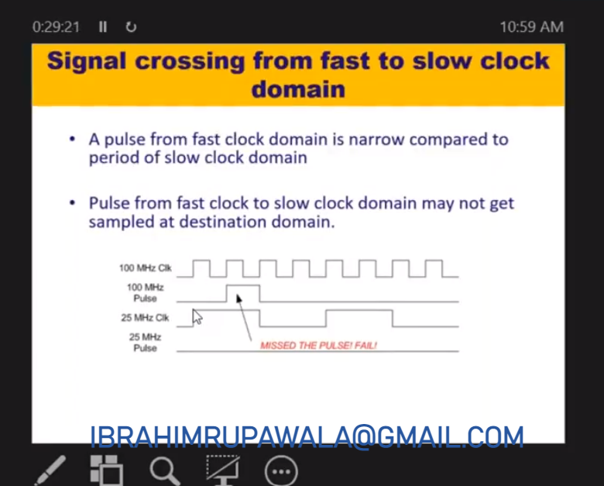

Slide 25
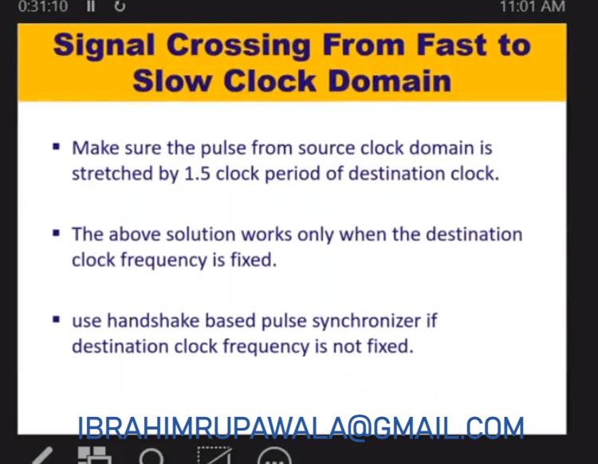

Slide 26
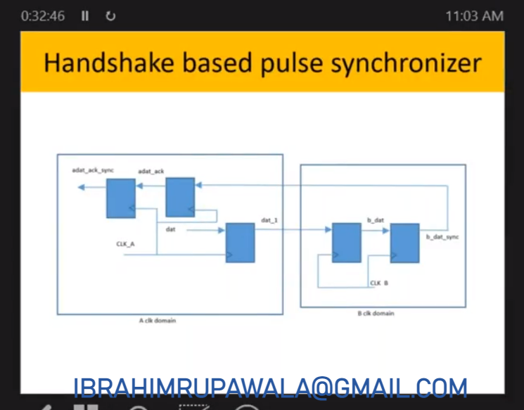

Slide 27
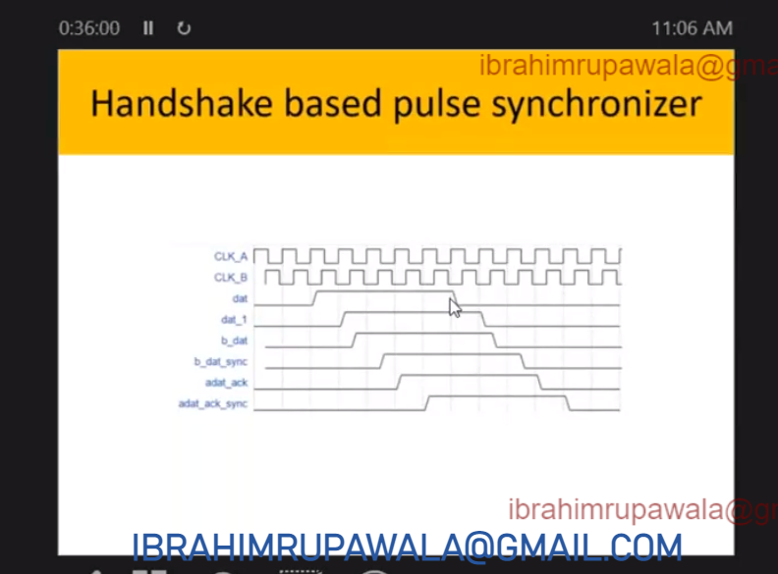
CDC - Handshake Based Pulse Synchronizers
Dat will go low only after add_ack_sync is received.
This way you’re making sure that you’re elongating the pulse until it is received successfully by slow clock domain without knowing the frequency of destination clock

Slide 28
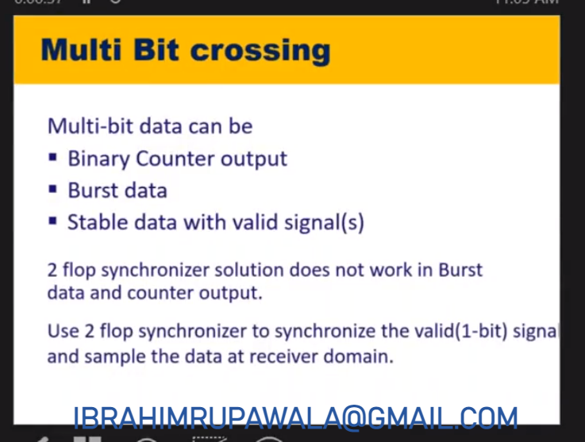
Multi Bit Crossing

Slide 29
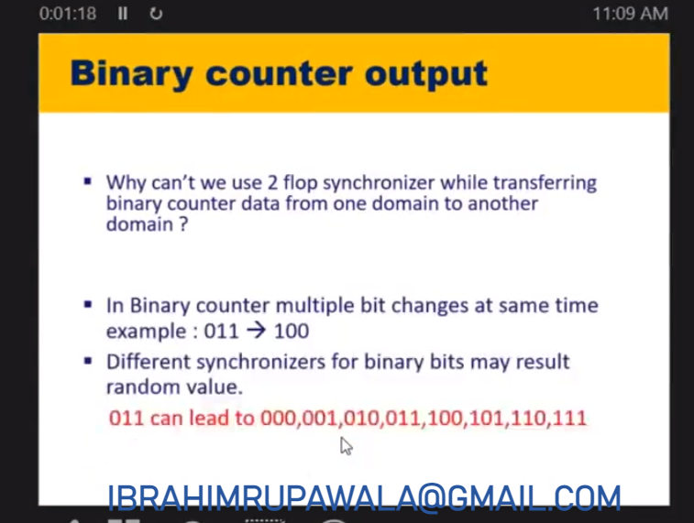
Multi Bit Crossing

Slide 30
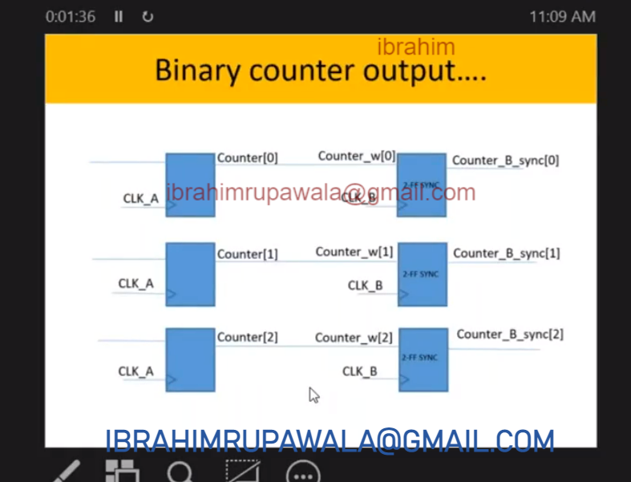
Multi Bit Crossing

Slide 31
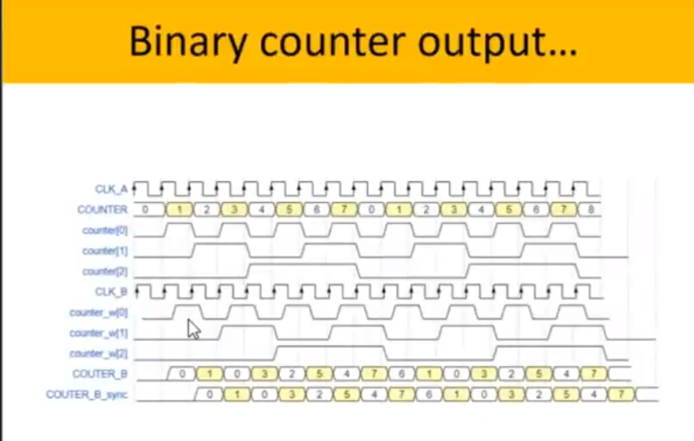
Notice that counter_w[0], counter_w[1], is having some delay compared to counter[0], counter[1] because of some wire delay.
Hence sampling at CLK_B is different then 0,1,2,3 which is wrong.
Incorrect sampling of counter_B

Slide 32
Notice that this problem is happening because multiple bits are changing at one time to eliminate this issue use gray counter which only changes one bit at a time
See this video to understand gray code conversion
https://www.youtube.com/watch?v=R7uuIACpdGQ

Slide 33
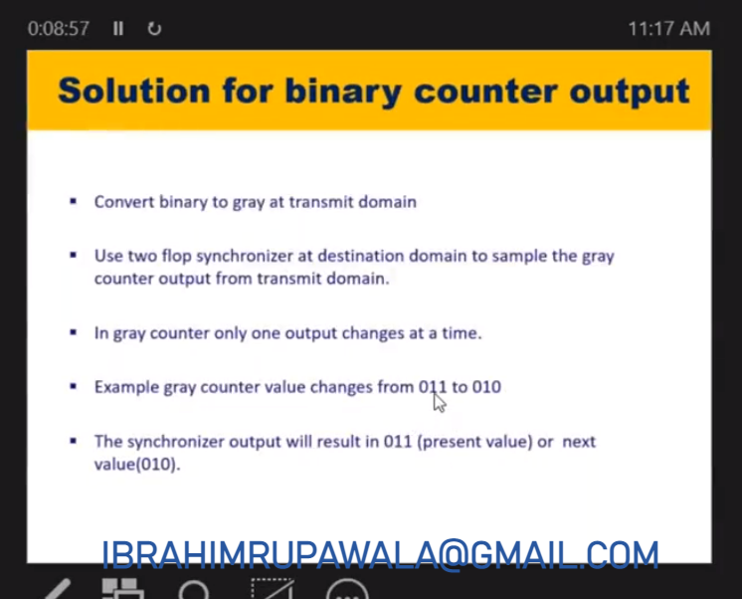
3 two flop synchronizers will be used at destination
Now the synchronizer output will result in 011(present value) or next value(010) but not any random value as observed previously.

Slide 34
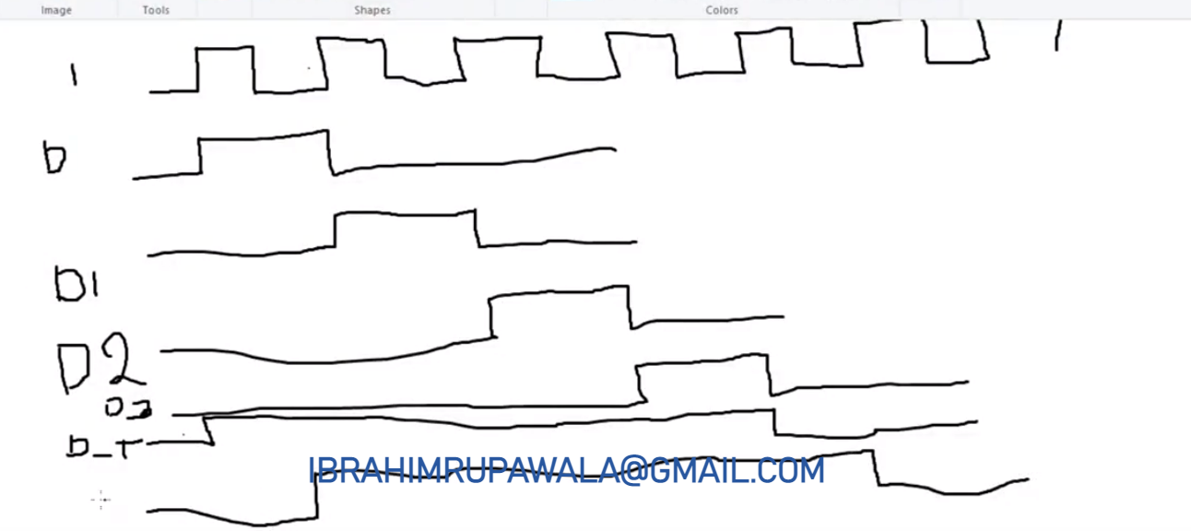
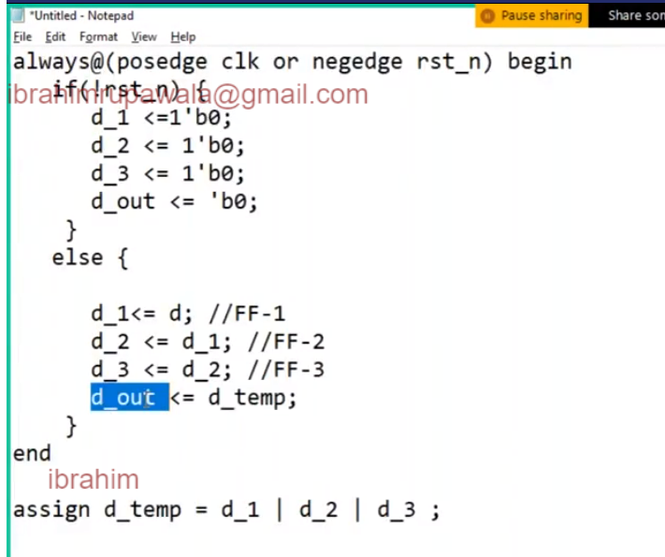
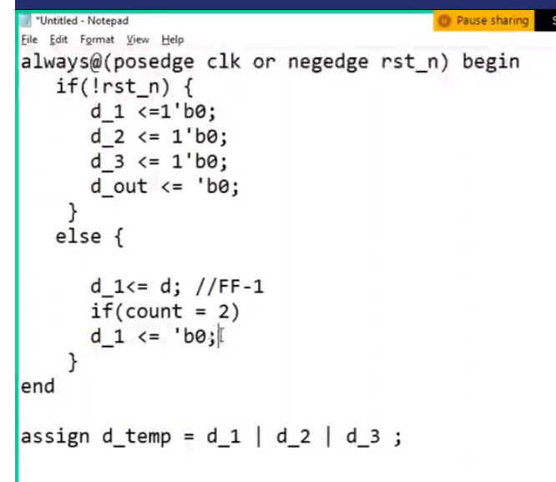
How to code the stretched data from one domain passing to another domain

Slide 35
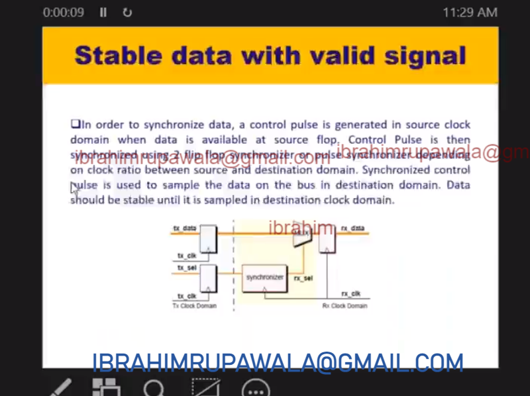
Stable data with valid signal. Tx_data will be sampled only when tx_sel is valid otherwise retain old data.
Notice here that CDC will throw the error as the datapath is not synchronized hence we have to ask spyglass to waive the error.
Used the synchronized rx_sel to sample the data

Slide 36
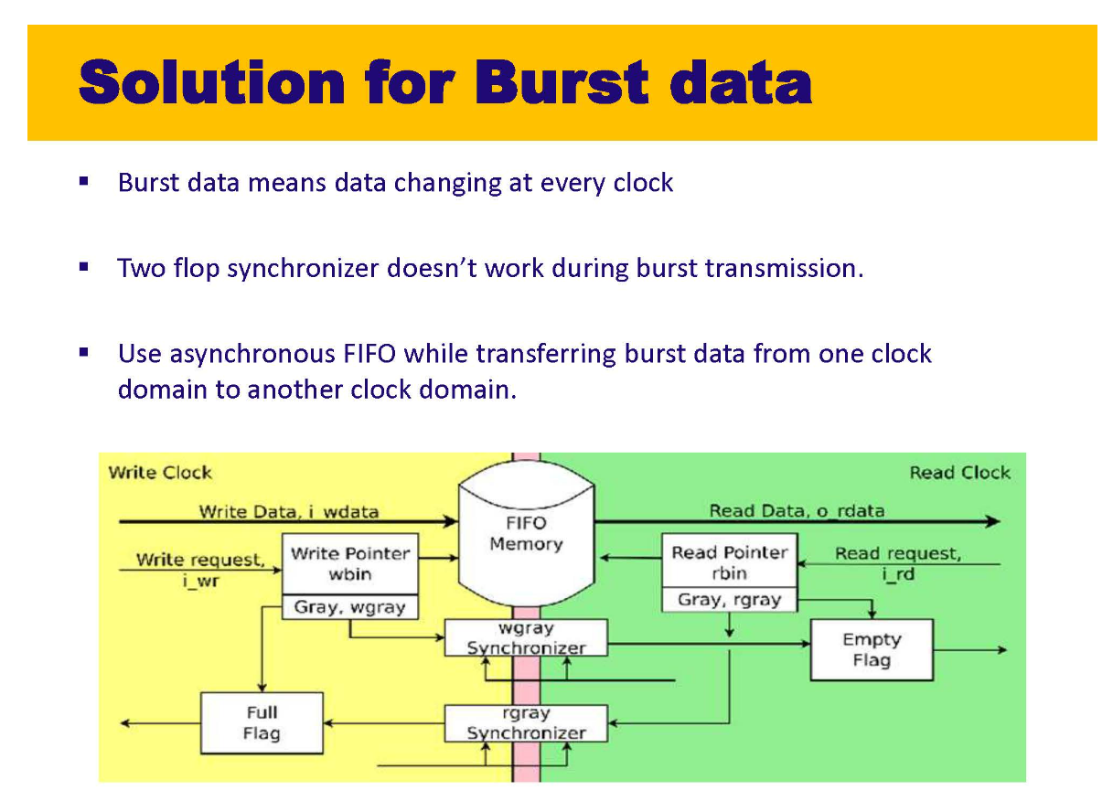

Slide 37
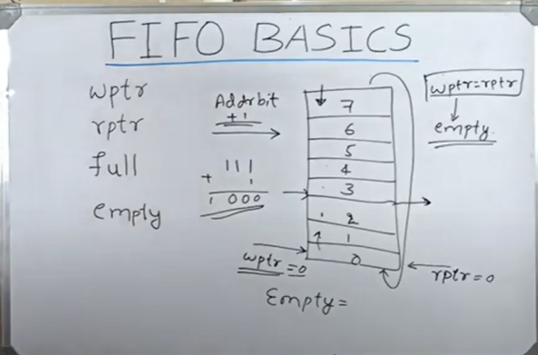
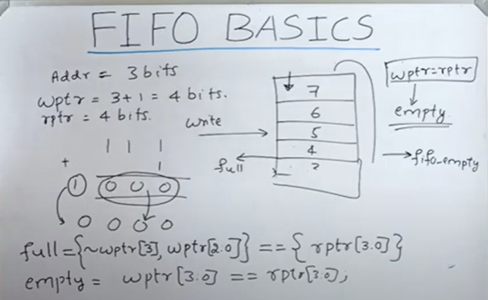
Videos on FIFO
Notice that burst data cannot be synchronized with two stage synchronizers. For this we have to use Asynchronous FIFO’s
Synchronous FIFO’s have both read clock and write clock from the same domain.
https://www.youtube.com/watch?v=dCj5HAnaCd8

Slide 38
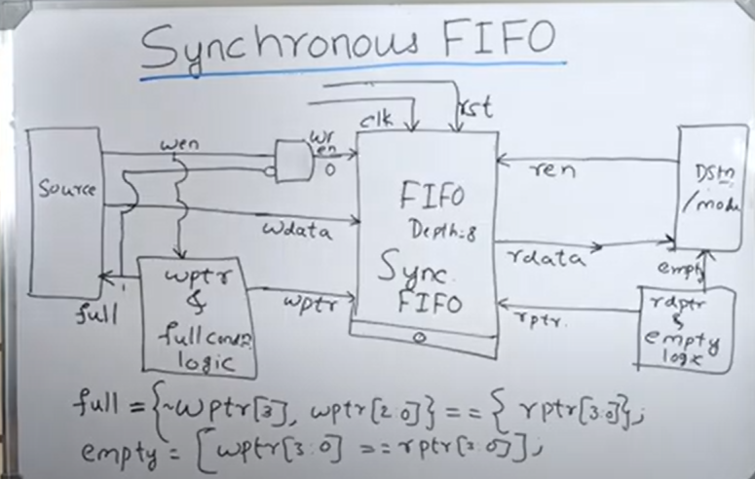
Synchronous FIFO
https://www.youtube.com/watch?v=FmapuHOFmec

Slide 39
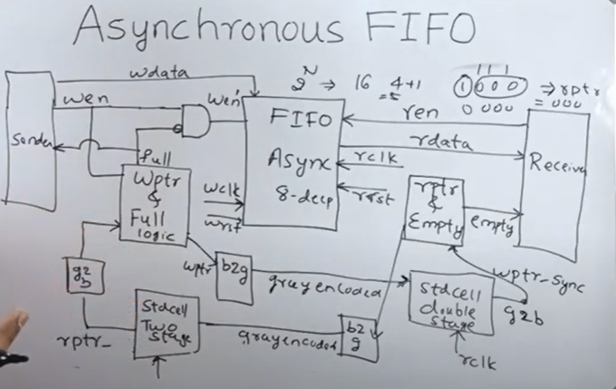
Asynchronous FIFO
Used when you want to transfer multi-bit data from one clock domain to another clock domain
https://www.youtube.com/watch?v=mGREY8u9ELs
Note however for the Asynchronous FIFO that it only works for 2^N bits long data because the empty and full conditions are determined by most significant bit. Please refer last slide for the formula for empty and full.

Slide 40
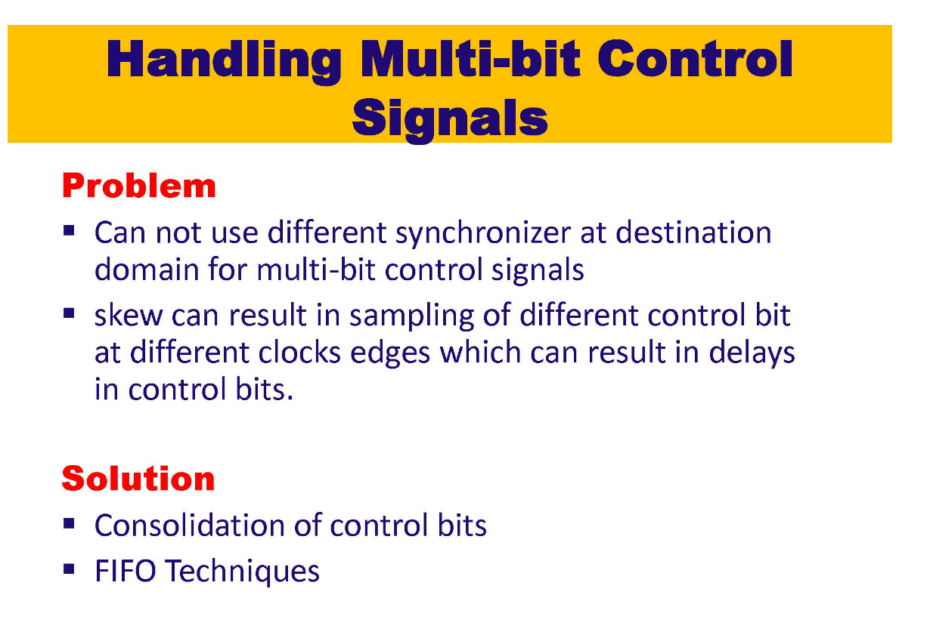
Consolidation means instead of sending 2 signals only send one signal. But this is not always feasible.
Consolidation happens in source clock domain only

Slide 41
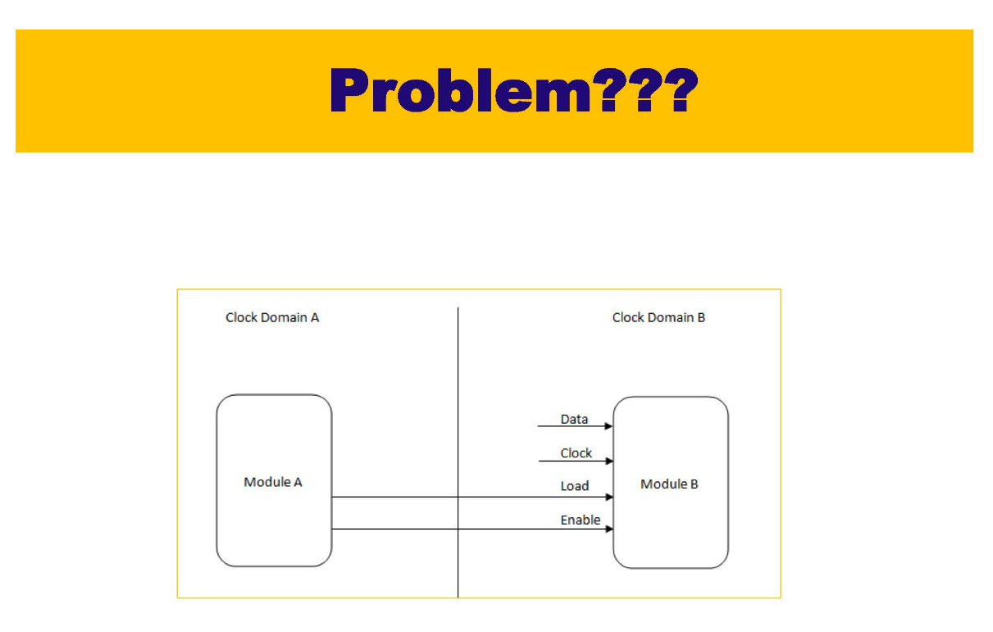

2 control signals (en_a and load_a) are going from clock domain a to clock domain b
Data is registered to b-domain only if en_b_sync and load_b_sync is enabled.

Slide 42

load_b_sync
en_b_sync
If there is a skew in en_a then en_b is captured at next clock domain and due to this note that the final signals en_b_sync and load_b_sync are not high at the same time and hence the DATA is never registered.
Note that load_b and load_b_sync are captured correctly and hence that signal is not delayed.

Slide 43

Consolidation of control bits
Instead of sending load_b_sync and en_b_sync it is possible for the designer to just send one consolidated signal as shown below

Slide 44

2nd example

Slide 45

2nd example

Slide 46

2nd example

Slide 47

2nd example

Slide 48

2nd example

Slide 49

Any combinational logic should not be placed before the synchronizer as it will make the data path glitchy and we know that MTBF is inversely proportional to the frequency of data and frequency of the capturing clock.
Hence data with glitches reduces MTBF.

Slide 50


Slide 51

Convergence
Output from two flops converging into combinational logic and going out. We should never do this.

Slide 52


Slide 53

Don’t diverge the signal. Synchronize the signal and then use it as many times as you want

Slide 54


Slide 55

CDC will also check if we have proper reset synchronizers or not.
There are two things possible here 1. synchronous reset 2. Asynchronous reset with synchronous release.
1. Synchronous reset both assert and release will happen at the clock edges.
2. Asynchronous reset with synchronous release assert happens synchronously while release happens at the clock edge.
How do you synchronize tx_sig with rx_clk ?
Whenever tx_sig reset asserted at the first clock, if assertion is on the edge of the clock the output of first clock may go to metastable hence we mask it using second flop
But release happens at the clock pulse, this happens after two clock pulse hence there is a 2 clock pulse delay between assertion and de-assertion of the reset

Slide 56



Reset Synchronizer
https://www.youtube.com/watch?v=vmy5E1fmQIQ

Slide 57
When you apply reset both the flops will go to zero immediately but when you remove the reset first flop will come out of the reset (=1) at the first clock edge and second will come out at the second clock edge.
The output of S1 is used for re-setting the flops, which are there in rx_domain. If we have a separate clock then we will have another reset synchronizer for it.
If you release asynchronously both the flops will go to metastable state.
Reset recovery and Reset removal window ??
Reset recovery window means you can’t release reset immediately there will be two clock delay

Slide 58




Synchronous and Asynchronous Reset
Double synchronizer is used for the de-assertion because we do not want reset to go to metastability if it is released during the reset recovery and reset removal window.
Glitch can also cause reset hence there is always a requirement for the length of the reset
https://www.youtube.com/watch?v=tB3dz4aDgGg
Notice that even Asynchronous reset has asynchronous assertion while de-assertion is always w.r.t clock
Notice above that reset was never captured

Slide 59
Reset Domain Crossing – Electronicspedia
https://www.youtube.com/watch?v=3XM27u0aMi0&list=PLxJxAeXlg414fp3qr98W4CR9cw1UT6avn&index=4
https://www.youtube.com/watch?v=92CaNoOlKfk

Slide 60


Reset Domain Crossing (RDC)
Notice that Reset Recovery time and Reset removal time only comes into picture when reset is de-asserted as for the asynchronous clock reset removal happens synchronously with clock.
Data is crossing the boundary from one reset domain to another domain

Slide 61


Reset Domain Crossing
RDC is very difficult to catch as compared to CDC. There are various methods to check it
1) RTL Fix – Notice how we can use double synchronizer in between two reset domains (same like CDC)

Slide 62


Reset Domain Crossing
2. Reset ordering
Notice that issue happens when reset2 is de-asserted and reset1 is asserted.
Hence in this method we will ensure that reset2 is asserted when reset1 is asserted hence even if the output from FF1 is in metastable state it doesn’t matter as FF2 is in the reset state.
3. Clock Gating
In this method when the reset1 is de-asserted you gate the clock2 and does not allow the data to be sampled when it might go to metastable state.
4. Waiver/ Constraints
Waive the failures using constraints in spyglass.

Slide 63

Clock Gating
Clock gating is used to switch off the blocks and save power because we know that Dynamic Power is proportional to (switching_activity)(C.VDD^2.F).
Notice that the clock gating techniques shown using an AND gate is not helpful in the actual designs as it chops off the clock signals at the ends and creates glitches signal.
To Overcome this scenario we use latch based clock gating techniques.
https://www.youtube.com/watch?v=de5iH6CHr8E&list=PLxJxAeXlg414fp3qr98W4CR9cw1UT6avn&index=1

Slide 64



Latch Based Integrated Clock Gating
As the AND gate clock gating is prone to clock chopping Integrated clock gating ensures that only full clock pulse are captured by forcing the enable signal to toggle only during clock edge with the help of a latch.

Slide 65

Ac_glitch03 is having comb logic at the end of the transmitting side.

Slide 66

Unregistered SINGLE BIT data going from one clock domain to another

Slide 67


Slide 68

Unregistered MULTI BIT data going from one clock domain to another

Slide 69

Using a synchronizer for select signal of Mux to register when the correct MULTI BIT data is available

Slide 70

Notice that AND gate output from one domain is going directly to other domain. We should always send registered output from one domain to other or else glitch will be propagated to other domain if we send combinational data output to other domain directly

Slide 71


Slide 72


Slide 73

Reset is Synchronized by adding 2 stage synchronizers

Slide 74

Yellow Line shows the convergence of the data signal

Slide 75

Reset should also be synchronized only once. See the blue path

Slide 76

For CDC we have to provide to the tool RTL, CDC Goals and Design Intent (Which tells the tool which are the separate clock domains)

Slide 77


Slide 78


Slide 79


Slide 80

Step1: capture all clks and resets

Slide 81

Step2: Write constraints for a custom FIFO structure already defined (but not recognized by tool) in the design

Slide 82

Disable False Handshake protocol synchronizer

Slide 83


Slide 84


Slide 85


Slide 86


Slide 87

Waivers will mass all the CDC bugs on that path.
Constraint based CDC are assumptions under which the CDC is checked. Waivers does not have that facility.
Constraints provide flexibility of performing CDC analysis in one particular mode.
Based on the set case analysis(from one mode example checking design w.r.t just one clock) CDC tool will verify statically (CDC analysis).
Now this same constraints can also be used to check design dynamically (functionality check).
Using constraints we can generate assertions (vectors) using SpyGlass which will be applied to our RTL which will further generate a database which can be loaded to the tools like Verdi to check the functionality dynamically.
Notice that large companies does not perform CDC functional analysis this is done by UVM verification team.
Most companies only perform CDC static (structural) analysis. CDC functional analysis is one more level of functional verification using CDC

Slide 88


Slide 89


Slide 90


Slide 91


Slide 92


Slide 93


Slide 94


Slide 95


Slide 96


Slide 97


Slide 98


Slide 99


Slide 100


Slide 101


Slide 102


Slide 103


Slide 104


Slide 105


Slide 106


Slide 107


Slide 108


Slide 109


Slide 110


Slide 111


Slide 112


Slide 113


Slide 114


Slide 115


Slide 116


Slide 117


Slide 118


Slide 119


Slide 120


Slide 121


Slide 122


Slide 123


Slide 124


Slide 125


Slide 126


Slide 128


Slide 129


Slide 130


Slide 131


Slide 132


Slide 133


Slide 134


Slide 135


Slide 136


Slide 137


Slide 138


Slide 139


Slide 140


Slide 141


Slide 142


Slide 143


